Slide 1
Chapter 7 Output Feedback
Wei Liu

Slide 2
Contents
7.1 Observability
7.2 State Estimation
7.3 Control Using Estimated State
7.4 Kalman Filtering
7.5 A General Controller Structure

Slide 3

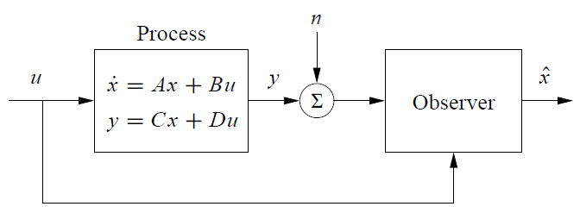
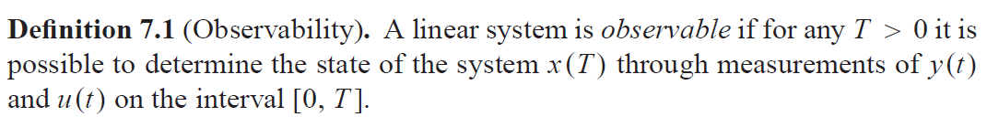
7.1 Observability
Consider a system described by a set of differential equations
Figure 7.1
The definition above holds for nonlinear systems as well.

Slide 4


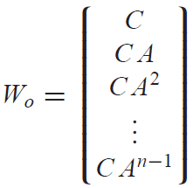
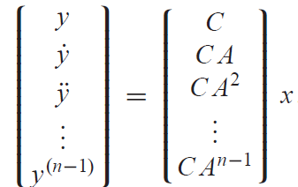
7.1 Observability
Neglect the input and focus on the autonomous system
observability matrix

Slide 5
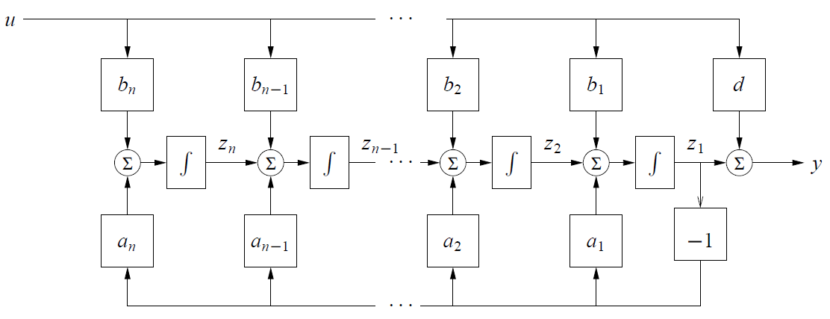
7.1 Observability
Observable Canonical Form

Slide 6
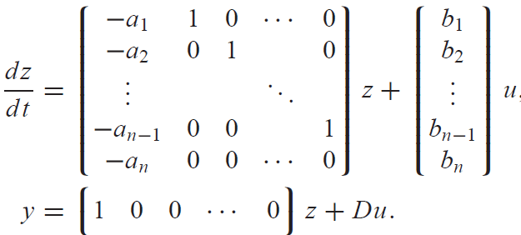
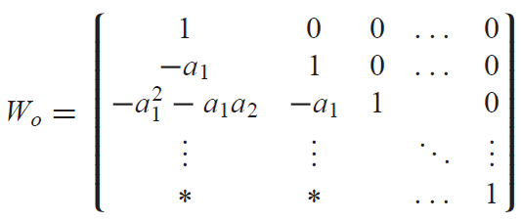
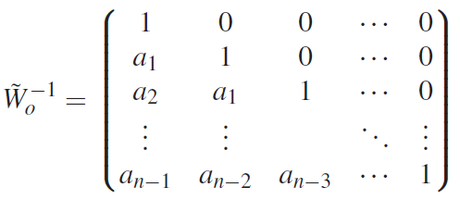
7.1 Observability
Observable Canonical Form
A linear single-input, single-output state space system is in observable canonical form if its dynamics are given by

Slide 7







7.2 State Estimation
We wish to construct a dynamical system of the form
is an estimate of the state with the property that
Consider the system in equation (7.1) with $D$ set to zero
Design the observer
estimation error
If the matrix $L$ can be chosen in such a way that the matrix $A − LC$ has eigenvalues with negative real parts, the error will go to zero.

Slide 8
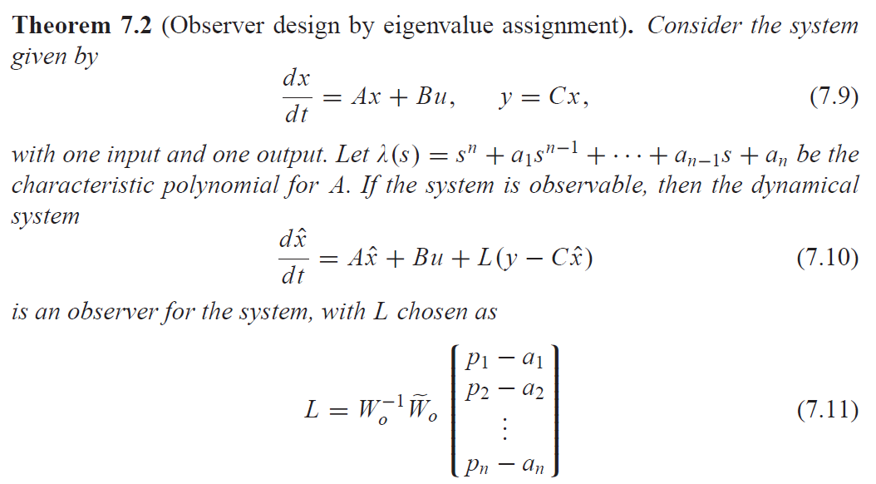
7.2 State Estimation

Slide 9
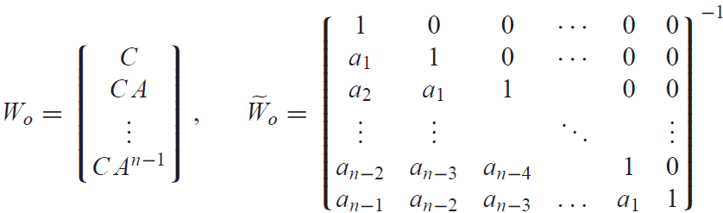
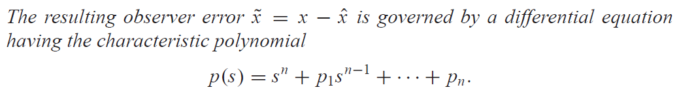
7.2 State Estimation

Slide 10
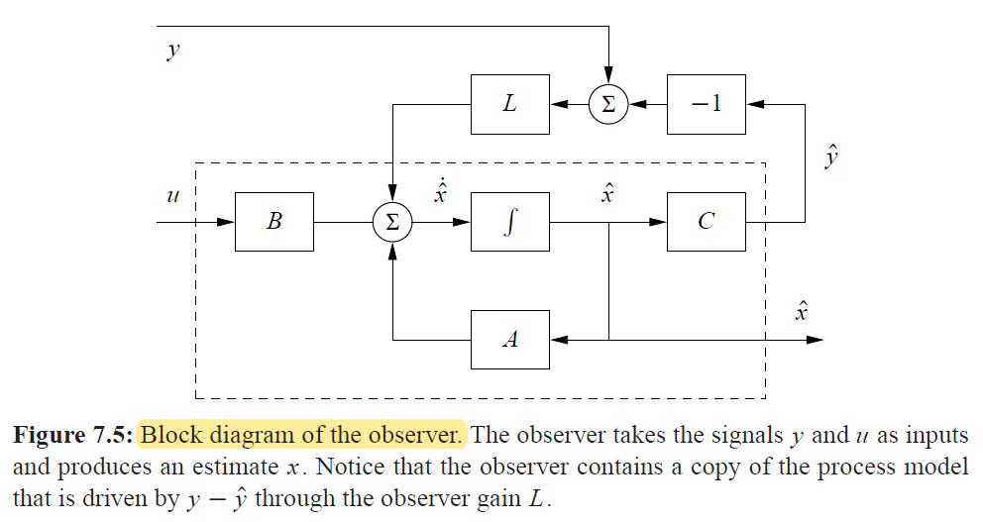
7.2 State Estimation

Slide 11
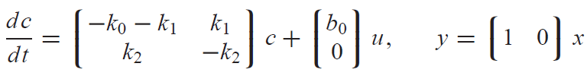




7.2 State Estimation
Example 7.2 Compartment model
the observability matrix
observable if $k_{1}≠0$.
The characteristic polynomial
The desired characteristic polynomial of the observer

Slide 12
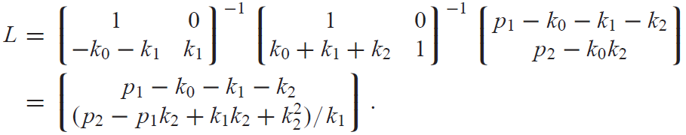
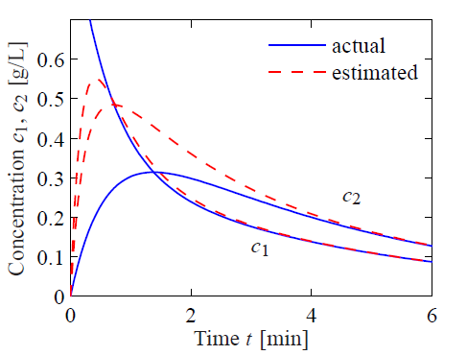
7.2 State Estimation
Example 7.2 Compartment model

Slide 13





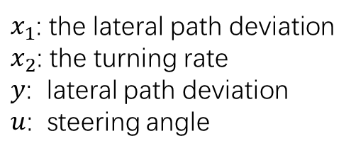
7.2 State Estimation
Computing the Observer Gain (Example 7.3 Vehicle steering)
$x_{1}$: the lateral path deviation
$x_{2}$: the turning rate
$y$: lateral path deviation
$u$: steering angle
The characteristic polynomial
Assuming that we want to have an observer with the characteristic polynomial

Slide 14

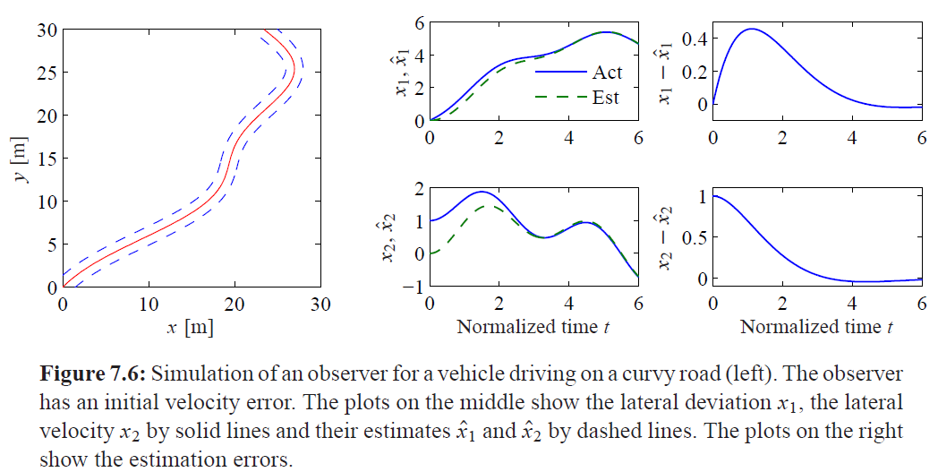
7.2 State Estimation
Computing the Observer Gain (Example 7.3 Vehicle steering)
The observer gains should be chosen as
The observer is then

Slide 15





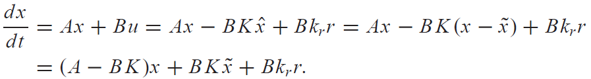
7.3 Control Using Estimated State
Consider a state space system of the form
State feedback control
If all states are not measurable
Subtract the observer equation from the system equation
Introduce the state feedback control with estimated state

Slide 16

7.3 Control Using Estimated State
The closed loop system is thus governed by
The characteristic polynomial of the closed loop system is
This polynomial is a product of two terms: the characteristic polynomial of the closed loop system obtained with state feedback and the characteristic polynomial of the observer error.

Slide 17
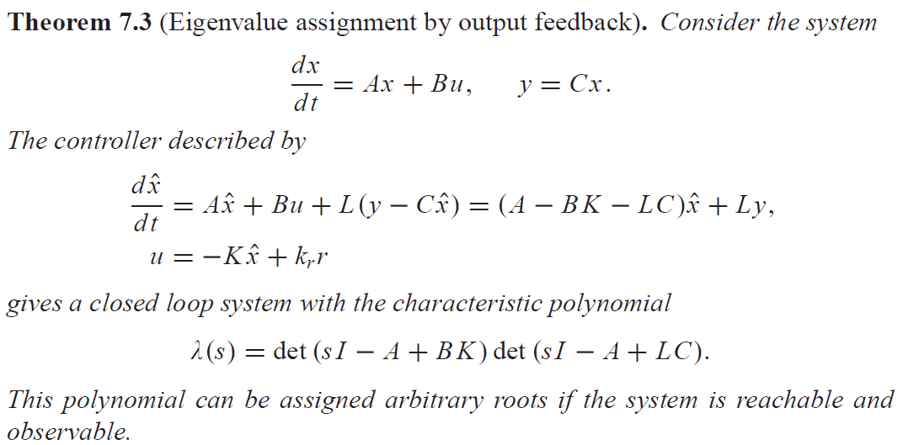
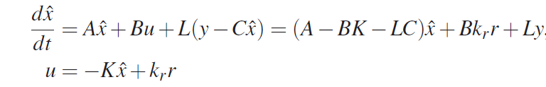
7.3 Control Using Estimated State

Slide 18
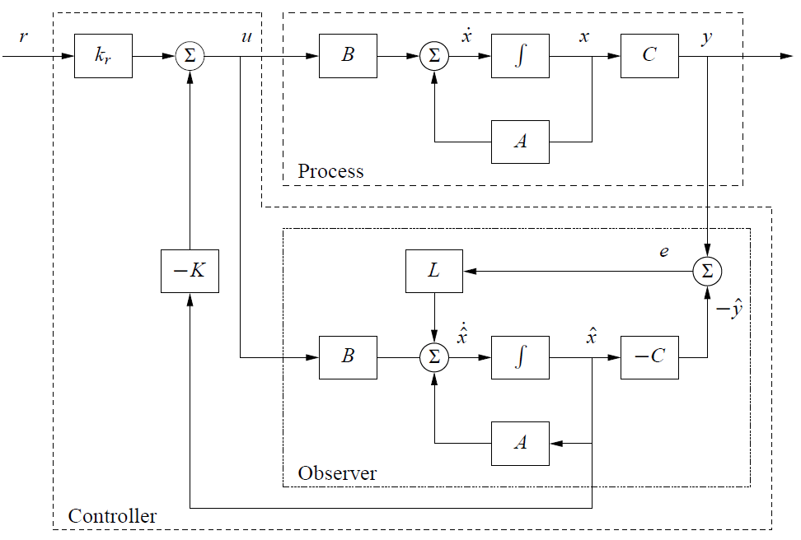
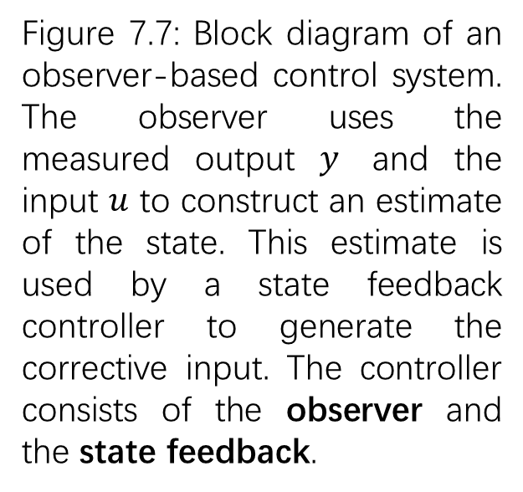
7.3 Control Using Estimated State
Figure 7.7: Block diagram of an observer-based control system. The observer uses the measured output $y$ and the input $u$ to construct an estimate of the state. This estimate is used by a state feedback controller to generate the corrective input. The controller consists of the observer and the state feedback.

Slide 19
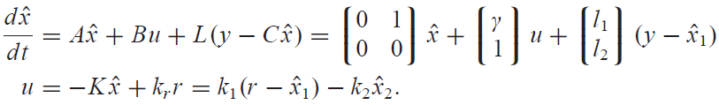
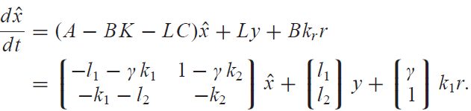

7.3 Control Using Estimated State
Example 7.4 Vehicle steering
Consider again the normalized linear model for vehicle steering. Combining the state feedback with the observer,
Elimination of the variable $u$ gives
The controller is a dynamical system of second order, with two inputs $y$ and $r$ and one output $u$.

Slide 20
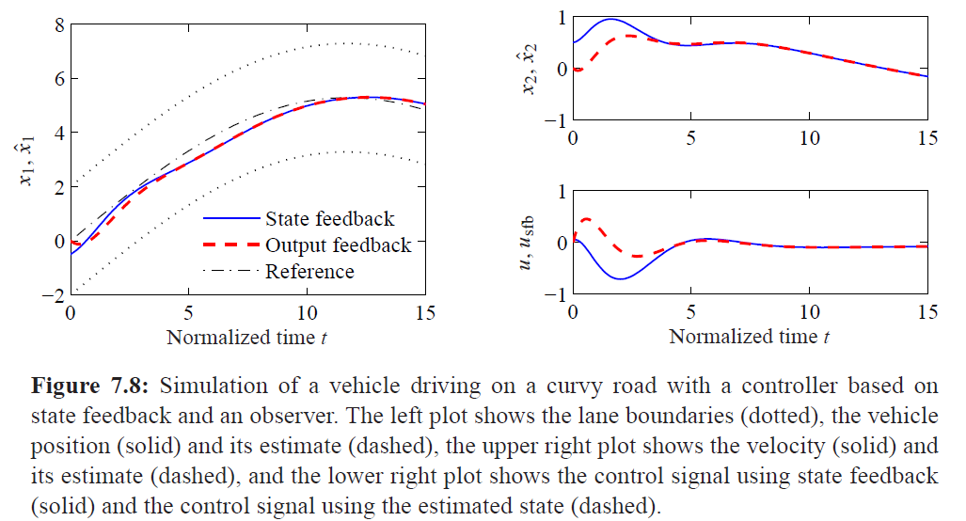
7.3 Control Using Estimated State
Example 7.4 Vehicle steering

Slide 21
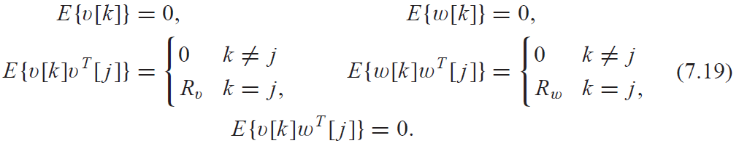
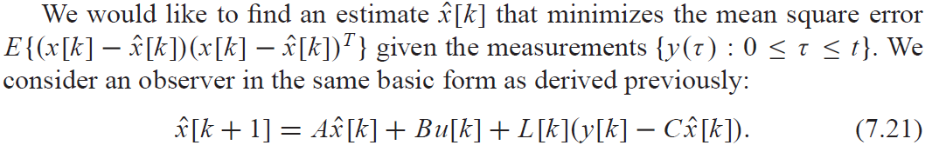
7.4 Kalman Filtering
Consider a discrete-time linear system with dynamics
The initial condition is also modeled as a Gaussian random variable with

Slide 22
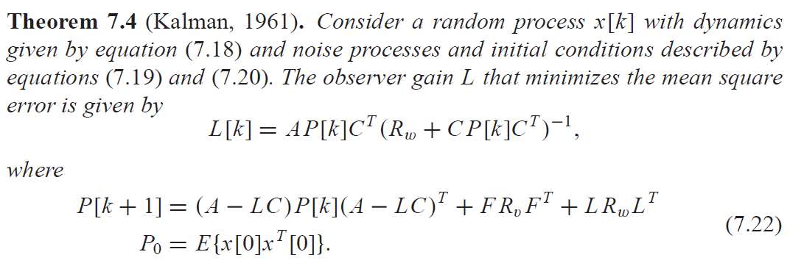
7.4 Kalman Filtering

Slide 23
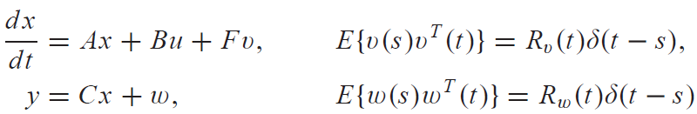
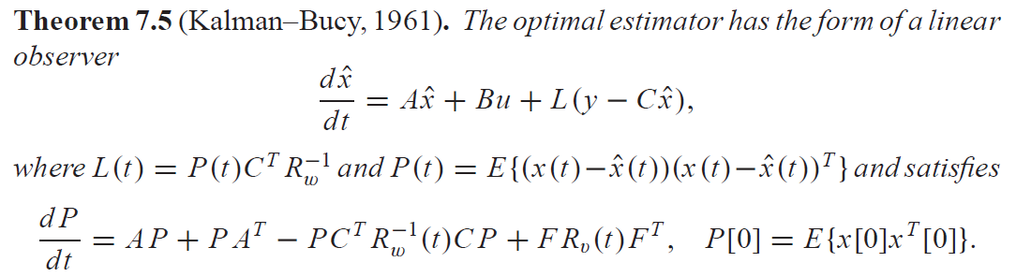
7.4 Kalman Filtering
The Kalman filter can also be applied to continuous-time stochastic processes.

Slide 24
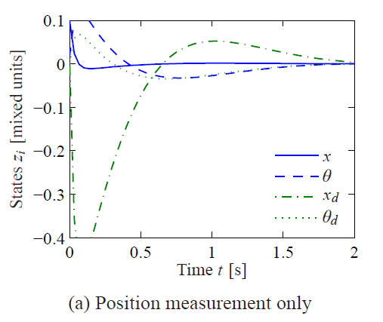


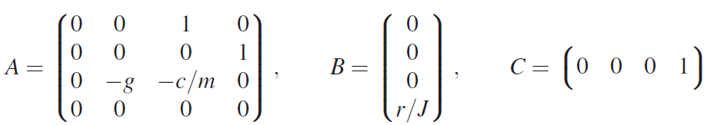



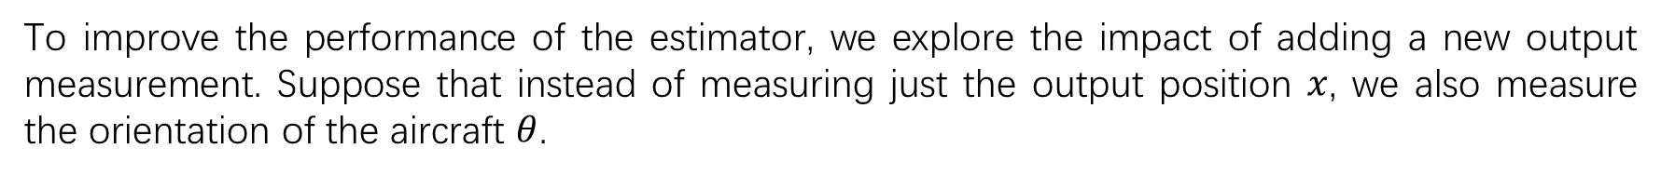
7.4 Kalman Filtering
Example 7.5 Vectored thrust aircraft
Consider the lateral dynamics of the system,
independent random variables with covariance
To improve the performance of the estimator, we explore the impact of adding a new output measurement. Suppose that instead of measuring just the output position $x$, we also measure the orientation of the aircraft $θ$.

Slide 25

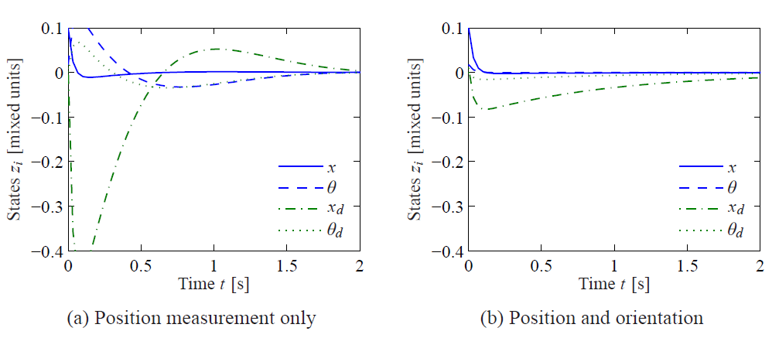
7.4 Kalman Filtering
The output becomes

Slide 26
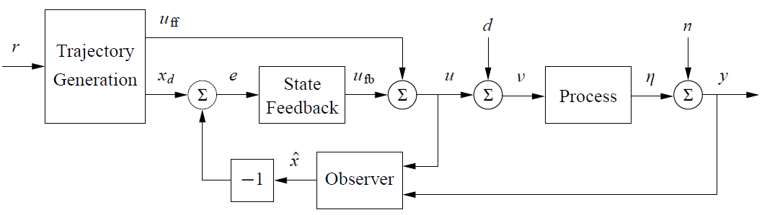




7.5 A General Controller Structure
Let
then the dynamics for the error:

Slide 27






7.5 A General Controller Structure
Linearize around $z=0$:
Design the state feedback control for the error:
controller
gain scheduled linear controller with feedforward
observer
Extended Kalman filter
Where L( ˆx) is the observer gain obtained by linearizing the system around the currently estimated state.

